Slide 1
Pitch Title?
Presented by Greg McIntyre & Tiffany Gray

Slide 2
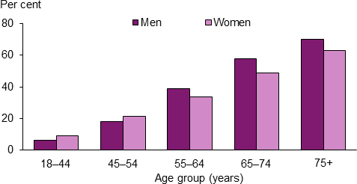
Prevalence of CVD in Australia from 2014-2015, by age and sex
Notes:
With an aging population also comes the higher risk of heart problems, for example congestive heart failure which is 10 times more likely in the elderly than in younger adults.
There are a few different types of heart failure and as they are chronic progressive conditions it is essential to monitor the hearts performance if cardiovascular issues are known or suspected.
Using a heartrate monitor is a non invasive way to keep track of an individuals heart rate and performance.
Graph: https://www.aihw.gov.au/reports/heart-stroke-vascular-disease/cardiovascular-health-compendium/contents/how-many-australians-have-cardiovascular-disease

Slide 3
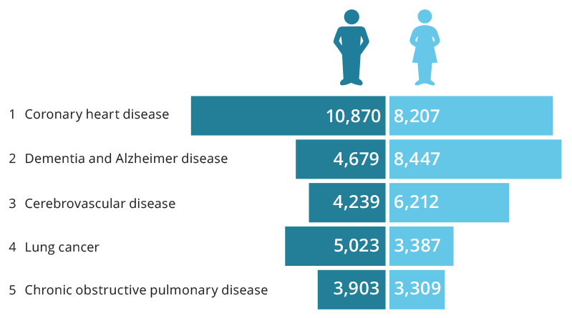
Leading causes of death by sex in 2016
Notes:
In Australia Coronary heart disease is the leading underlying cause of death, followed by dementia, Alzheimer disease, cerebrovascular disease (which includes stroke), lung cancer and chronic obstructive pulmonary disease (COPD).
An estimated 4.2 million (22%) Australian adults aged 18 years and over had 1 or more cardiovascular diseases in 2014–15, based on self-reported data from the Australian Bureau of Statistics 2014–15 National Health Survey. This includes conditions such as coronary heart disease, stroke, heart failure and hypertension.
In 2013, an estimated 65,300 people aged 25 and over had an acute coronary event in the form of a heart attack or unstable angina—around 180 events every day, based on hospitalisations and mortality data.
Graph: https://www.aihw.gov.au/reports/life-expectancy-death/deaths-in-australia/contents/leading-causes-of-death

Slide 4
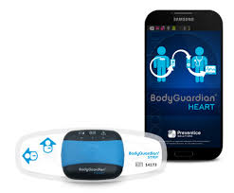
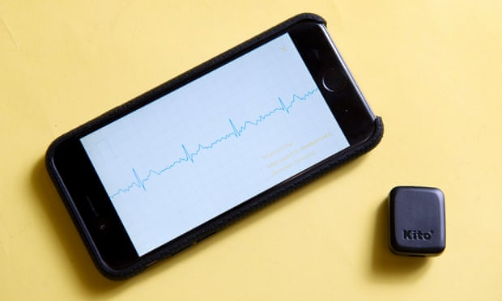
Existing Technology
Notes:
Existing technology:
Left Image: Body Guardian Sensor
Performs cardiac ECG and rhythm monitoring. A body worn sensor allows individuals to remain active and independent while their heart and general health are being monitored. The patient data is wirelessly delivered to the Preventice Care Platform, a cloud-based mHealth platform that collects real-time data from devices and delivers information to physicians.
Right Image: Kito+
The Kito+ has two ECG sensors, a skin temperature sensor, a heart rate sensor, and a blood oxygen sensor. After a scan lasting about 30 seconds with the index and middle fingers on each of the sensors, the companion app shows the blood oxygen, heart rate, skin temperature, ECG, and respiration rate.
Information:
https://www.wearable-technologies.com/2015/05/wearables-for-elderly/
http://www.preventicesolutions.com/
https://yourtechexplained.com/2016/04/02/kito-heart-monitor-gsl16/

Slide 5
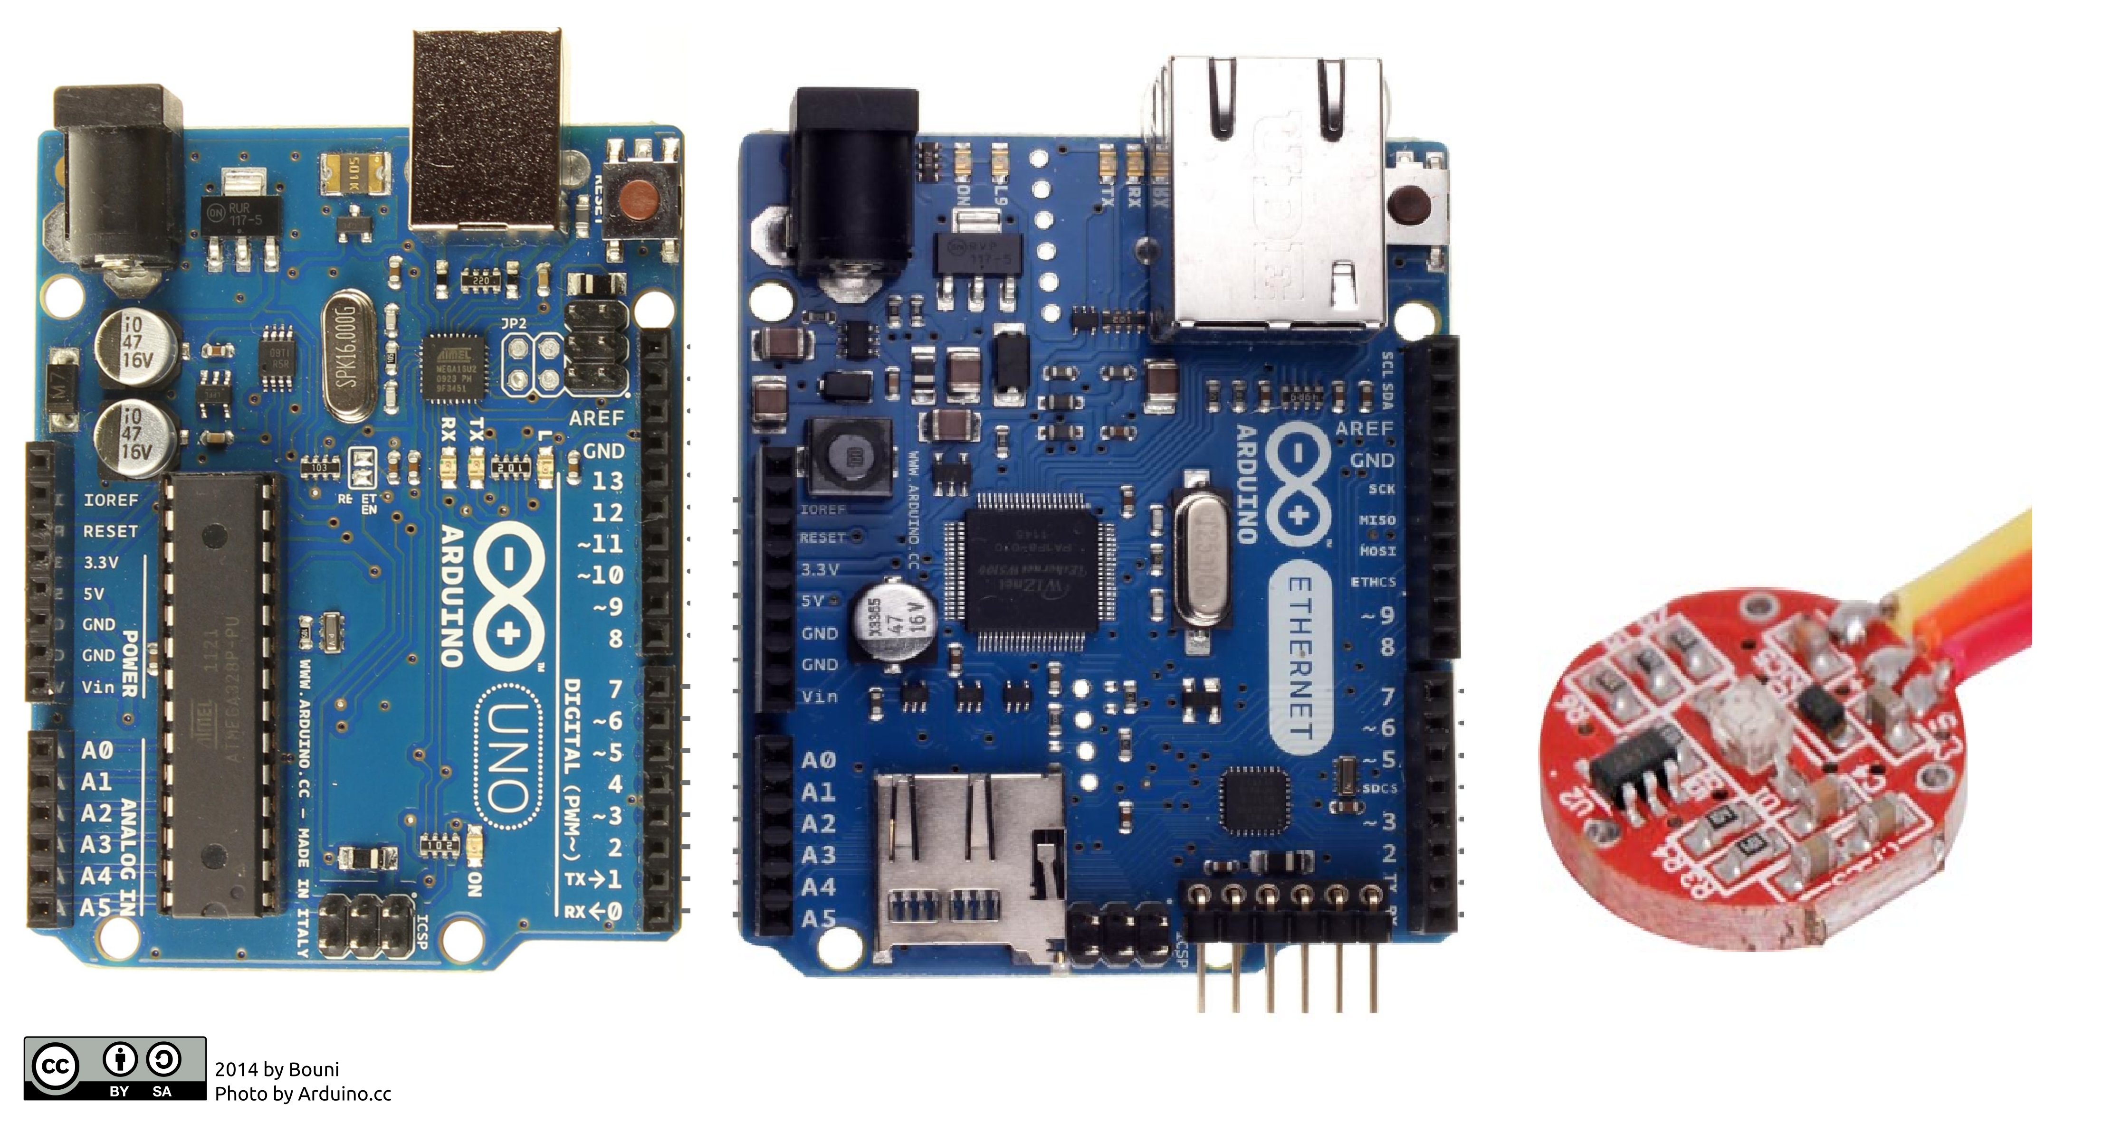
Sense
Notes:
The project will use a HR sensor to collect heart beat data

Slide 6
Think
Notes:
It will use a collection of this heart rate data to calculate the bpm of the user

Slide 7
Act
Notes:
If the heart rate is outside of normal levels it will alert using the ethernet shield.

Slide 8
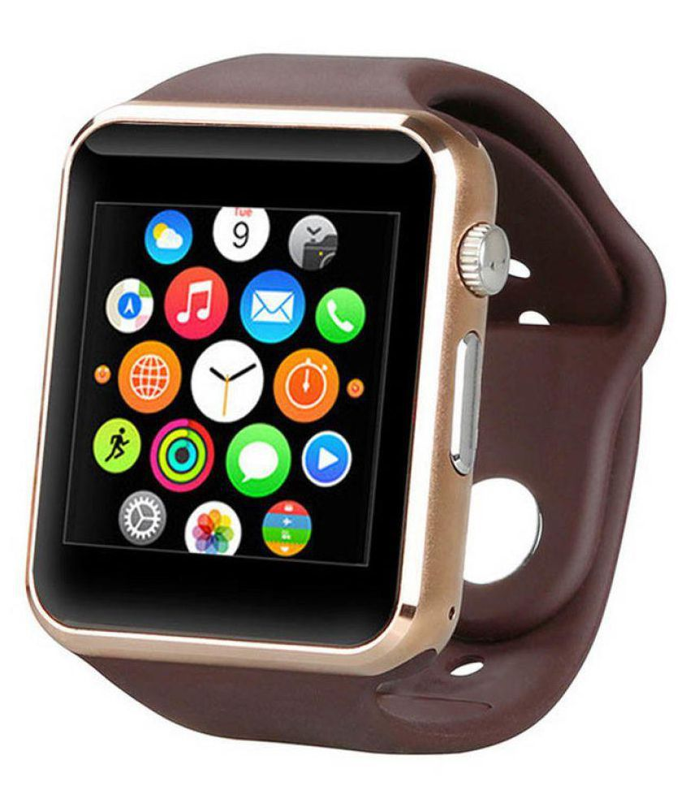
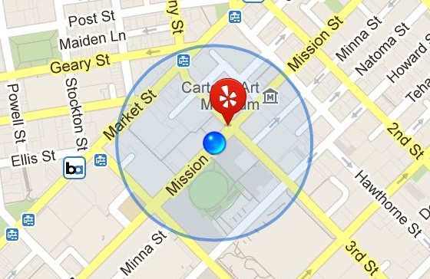
Future Tech
Notes:
Tech could be added into already existing smart watches.
They already calculate BPM and have GPS with certain apps, this could be taken further by constant monitoring and when irregular conditions are present pre-loaded emergency contacts will be notified and if heart beat stops completely then emergency services can be notified with GPS coordinates of the persons location.

